Slide 1

Inverted Pendulum Control using Reinforcement Learning
Team 1
Aalap Doshi
Poojan Patel
Varadaraya Ganesh Shenoy
EEE 511 Artificial Neural Computation
Final Project Presentation

Slide 2

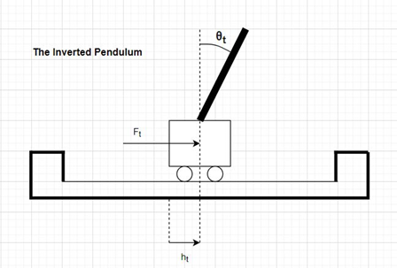
Problem Statement
The inverted pendulum is a popular research problem as it is an unstable system (i.e.) the pendulum will fall over if the movement of the cart doesn’t balance it. Thus, the primary objective of the control design is to apply a force to the cart in order to balance the pendulum.
Dynamics of the systems are Non-linear and it can be solved using only simple control systems with PID controller. A real world example that relates directly to this inverted pendulum systems is the attitude control of a booster rocket at takeoff.
To understand the simple inverted pendulum we worked on mathematical calculation in MATLAB with many assumptions such as mass of cart and pendulum, length of pendulum and many other environmental parameters.
We did the force analysis and system equation calculation in MATLAB and understood the need of a better approach and also use of neural network.
But to solve the above problem with only Control Systems Approach we need system dynamics otherwise it will fail. So, we took executed optimal control and reinforcement learning.

Slide 3
Designing optimal controllers continues to be challenging as systems inherently nonlinear. The principal advantage of reinforcement learning (RL) is its ability to learn from the interaction with the environment and provide optimal control strategy. Another reason to choose Reinforcement learning to is because cart-pole balancing is a benchmark for RL algorithms.
To solve the challenging task we tried many reinforcement learning algorithms in which agent has to select and take actions in a very limited and discrete action space.
We have used Reinforcement learning algorithm “Markov Decision Process” which takes inputs as states and in our systems we have 4 states (angle of pendulum and movement of cart), an action state which contains the force and movement of cart in left and right direction, transition state has the future output based on action and previous states and a reward function. We have assigned reward 1 if the system does not fail, and 0 otherwise.
To achieve the goal of finding a controller that maximizes the expectation. Specifically, we define the controller as a function of the states that outputs a number between 0 and 1. The numerical outputs is treated as probability for choosing action for example action 0 i.e. force to left and action 1 i.e. force to right.

Slide 4
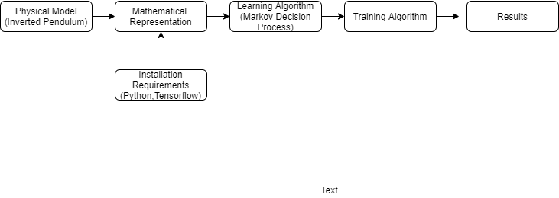
Working Algorithm

Slide 5
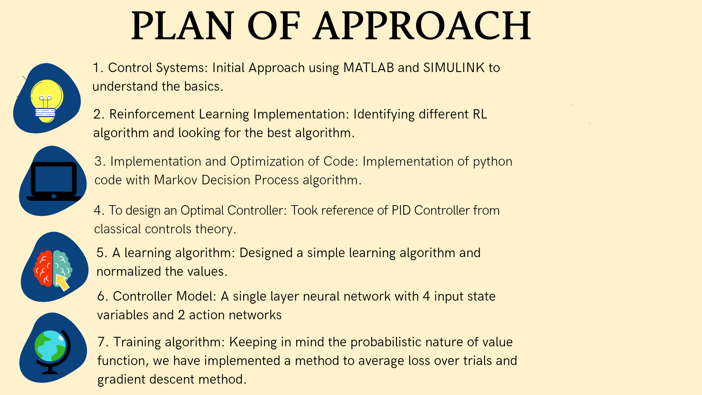

Slide 6
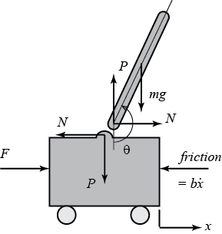
Model Representation
p
Summing the forces in horizontal and vertical directions of the cart, the equation obtained for the horizontal direction is shown in equation(1)
The following equation(2) is obtained by summing the forces in the horizontal direction and then by combining the eq(1) and eq(2) we will be obtain the 3rd equation.
When the perpendicular forces are applied to the pendulum, we will obtain the equation(4) which is the second equation for the motion.
In order to eliminate the P and N from the equation(4), the centroids of the pendulums are added which is shown in the equation(5) .
By combining the 4 and 5 equation we will get our final equation of the model for the inverted pendulum and cart which will help us to control different parameters.

Slide 7
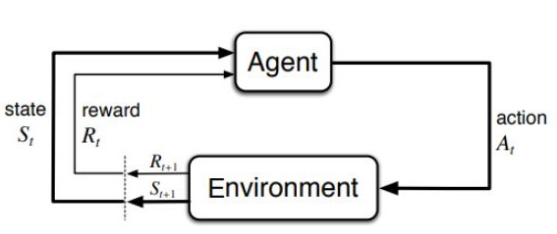
Markov Decision Process and
Reinforcement Learning
The four main necessary elements for RL are agent, environment, action and reward. RL is a multi decision process unlike supervised learning which has one instance, one prediction. So, as we know in a cart-pole system we have nonlinear dynamics so here RL can give us the best solution.
The Markov Decision Process in which action comes into picture this means that the next state is dependent on the previous state but also on the actions taking place in the current state.
In our system, if the cart the four state variables are adequate to represent action unit since the output for it is linear. The failure signal is given value -1 and 0 to other states. Failure occurs when the value of theta goes less than -12 or goes higher than 12 degrees. Evaluation unit is basically function of theta (pendulum’s angle) and theta.dot(angular velocity). With the pendulum moving towards balanced position, evaluation is closer to 0 which means a weaker prediction of failure. But we need to develop a different representation of function for evaluation unit.
Since the previous state and the next state changes at every microsecond we have designed a optimal controller which will check each and every failure signal and reduce the error by each iteration. This can be called penalizing.
Action network penalizes each control action of the pendulum for maintaining the angle and for cart to push left and right according the magnitude of force. Output of this unit is probabilistic which means the initial weights are zero and then the action units learn via a reinforcement learning method. With each movement it learns and assigns different weights to the system.

Slide 8
So, in the MDP algorithm the learning action takes place but it is very slow because of the delay signal. The two single layers 1) Action Network and 2) Evaluation Network performs specific tasks to stabilize system.
The Evaluation Network calculates the Temporal Difference (TD) which measures the sum of failure signals by prediction. The final prediction is based on failure signal and the previous prediction.Inner product of the input vector and unit weight vector gives output. Input vectors are the states of inverted pendulum and weights are developed by the TD method. With each ranking to the states the difference in the units output on the transition from one state to another is used to judge effectiveness of previous action. A decrease in failure signal proves that the evaluation is effective and probability of prediction is increased.
Mass Cart | 1.0
Mass Pole | 0.1
Pole Length | 0.5
Force | 10.0
Delta_t | 0.02
Theta_threshold | 12 degree
Delta_t | 2.4
Default System Parameters

Slide 9
IMPLEMENTATION
For the single layer implementation, softmax function is used to activate the neurons in the single layer.
One primary advantage of using softmax is that not only are the outputs are mapped to [0,1] range but also maps each output to ensure the total sum is 1. As a result , realizing a probability distribution. With a probability distribution output, it is easier to decide which action is to be taken to move to next state.
On the other hand , ReLu and its combinations are non-linear in addition to being a great approximator. But, it is unbound (ie) range of ReLU is [0,inf) which can blow up the activation.
In light of this upper hand in favour of softmax, softmax function is popularly used in reinforcement learning to convert values into action probabilities.

Slide 10
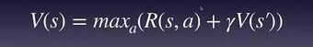
Since this project involves Reinforcement Learning, it would be incomplete without mentioning Markov Decision Process.
MDPs are popularly used to describe a fully observable environment.Therefore, implicating that most of the RL problems can be modelled as MDPs.
A Markov process or Markov chain as popularly called , is a tuple on the state-space S and the transition function P which represent the system dynamics.
Value Iteration based on Bellman’s Equation is an algorithm founded on the principles of Markov Decision Processes. Here , the agent attempts to acquire the most expected sum of rewards from every state it lands in. Thus, giving us the value of each state in the state-space.
It is not recommended to use Bellman’s Equation for our objective which is to balance the pole and not follow a policy to achieve a goal.

Slide 11
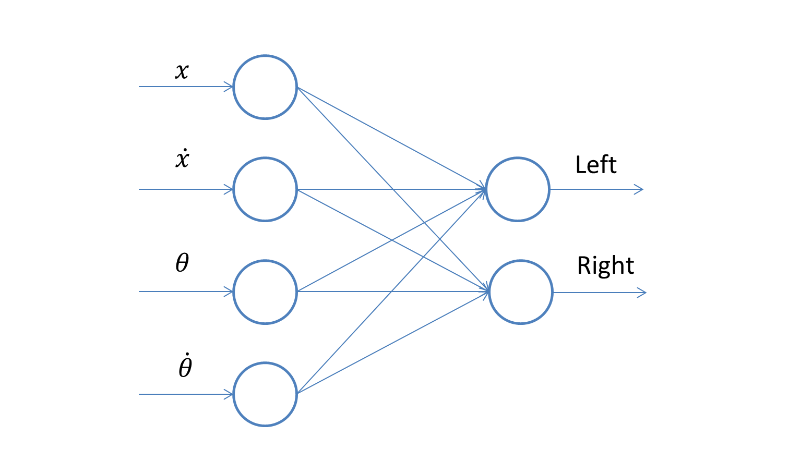
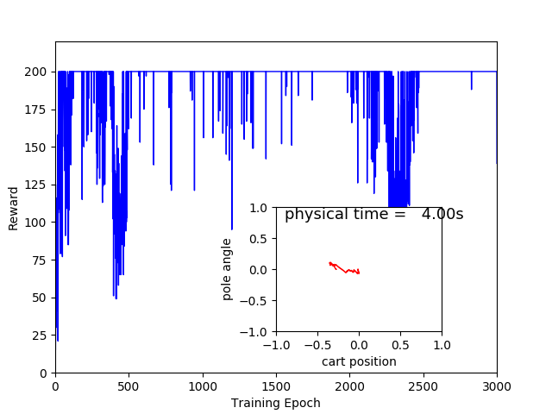
RESULTS
Single Layer Network
Pole Balancing
Convergence of Reward
The activation function is softmax while using ADAM and momentum optimizer
The pole is balanced successfully within an angle threshold of 12 degree and a cart displacement of 2.4 unit length.
From the figure, it is inferred a stable controller is learnt by the network which stabilizes the cart-pole system for 4 seconds for most of the trials.

Slide 12
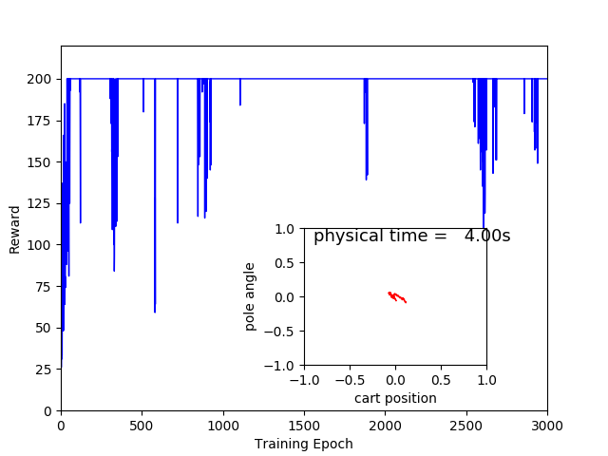
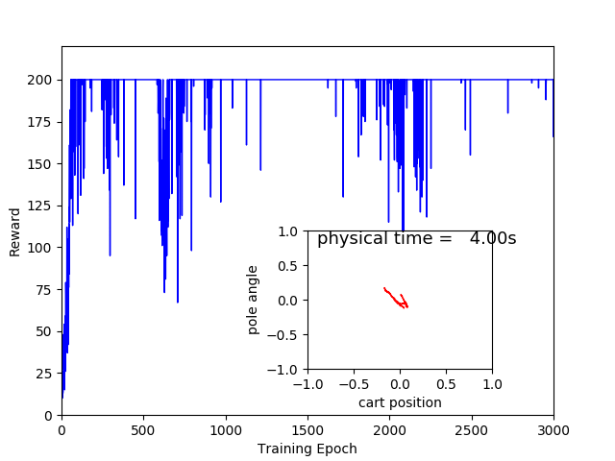
Fig(1) is the rewards when optimized using ADAM optimizer while Fig(2) shows reward optimization using Momentum optimizer.
The main difference between the two being that momentum optimizer helps accelerate SGD in relevant direction thus dampening oscillations. Whereas, ADAM optimizer computes adaptive learning rates for each parameter.On studying ADAM optimizer deeply, it compares favourably than its counterparts , also faring well practically.
It is also seen that when a hidden layer is incorporated, the controller fails more often mostly due to the fact the states are being normalized to a smaller value , thereby reaching ,albeit slowly, the lower bound of the controller.

Slide 13
Two layer- Network
Two units of the network:- 1) Evaluation Network 2) Action Network
Evaluation Network:-
This unit of the network is for the learning purpose of the model.
It consists of the four hidden layers which are connected with major input state parameters of the system.
Purpose of this network is to produce the failure signal for the controller.
Which gives zero as an output to introduce the states for false placement selection.
Action Network:-
Action network perform the same task as the evaluation network just for the different states parameter.
As the name suggest it provides the action signal to inverted pendulum mode .
With the help of the action signal controlling agent will be able to provide required position and angle to the model
It produces 1 as an output

Slide 14
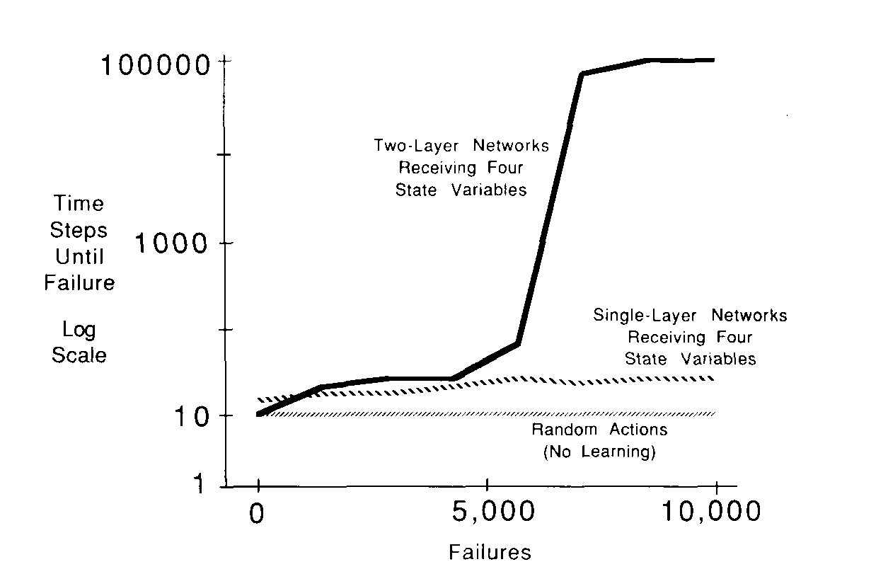
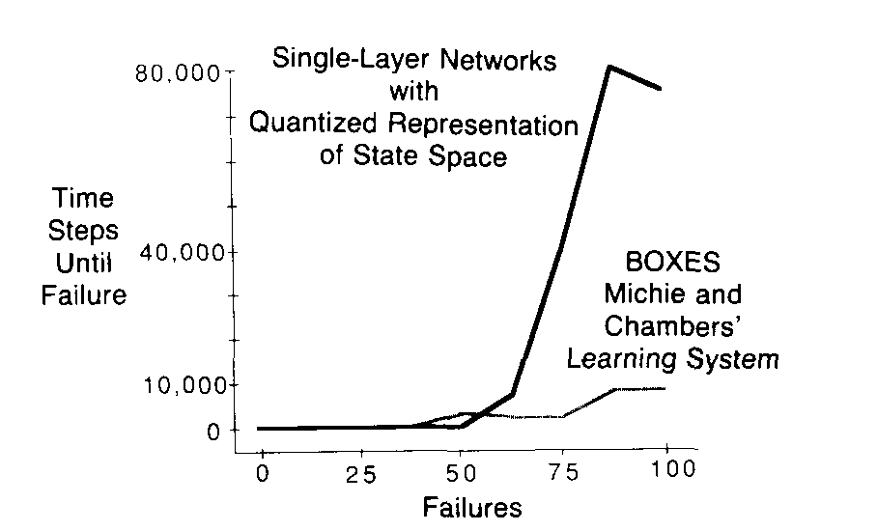
Two Single Layer Vs Two Layer
Curves shown in the figures are averaged results of the 10 experiments performed by Charles.w.anderson each starting with a network and terminated after the 10,000 failures or the 500,000 steps.
Two layer network learned to balance the pendulum for an average of about 24 mins in the real-time. Where the single layer networks ,when given the state variables as an input were unable to balance the pendulum actually doing slightly better than the general nonlinear control strategies.
When the state variables reset to zero for the neural network to learn to balance the pendulum.Two-layer network is unable to keep the position of the cart at the center but learned to balance with much lesser time.
With this advantage two-layer network implementation requires higher computation power and more complex training algorithm
With single layer approach we reached the desired goal but the two layer is one of the methods to look forward to solve this problem of control of inverted pendulum.

Slide 15
References
Literature
C. W. Anderson, “Strategy Learning with Multilayer Connectionist Representations,” Tech. Rept. TR87-509.3, GTE Laboratories, Waltham, MA, 1987. (This is a corrected version of the report published in Proc. Fourth International Workshop on Machine Learning, Irvine, CA, pp. 103- 114, June 1987.)
Charles.WAnderson. “Learning to control an inverted pendulum using neural networks”. In: IEEE Control Systems Magazine 9.3 (1989), pp. 31–37. DOI: 10.1109/37.24809
K. C. Cheok and N. K. Loh. “A Ball-Balancing Demonstration of Optimal and Disturbance-Accommodating Control”. In: IEEE Control Systems Magazine 7.1 (1987). DOI: 10.1109/MCS.1987.1105235.
University of Michigan. Inverted Pendulum: System Modeling. URL: http : / / ctms . engin . umich . edu / CTMS / index . php ? example = InvertedPendulum & section = SystemModeling.
Link
https://designinformaticslab.github.io/mechdesign_lecture/2018/04/11/reinforcementlearning.html
http://ctms.engin.umich.edu/CTMS/index.php?example=InvertedPendulum&section=SystemModeling
Code
https://github.com/hope-yao/cartpole

